Slide 1

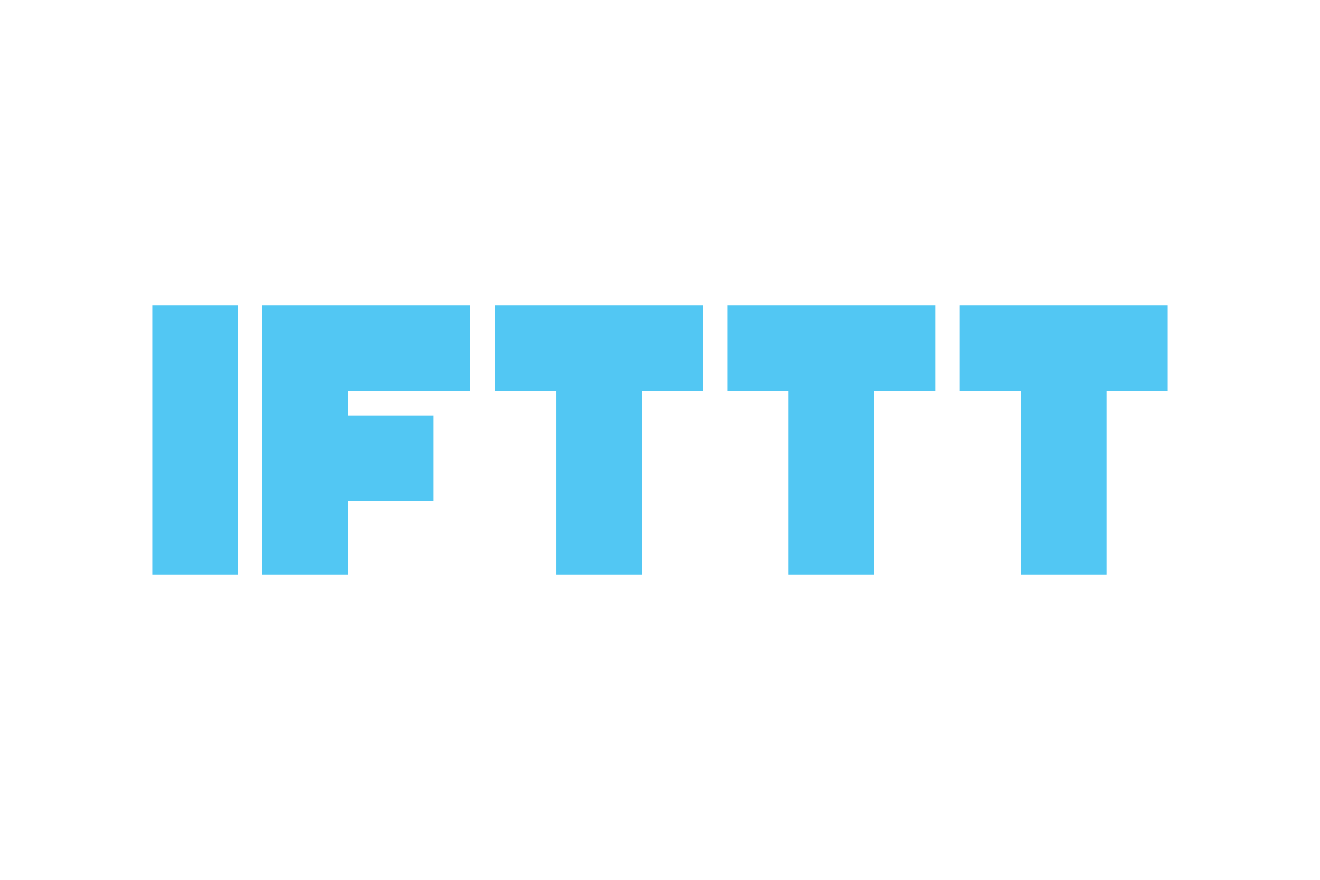
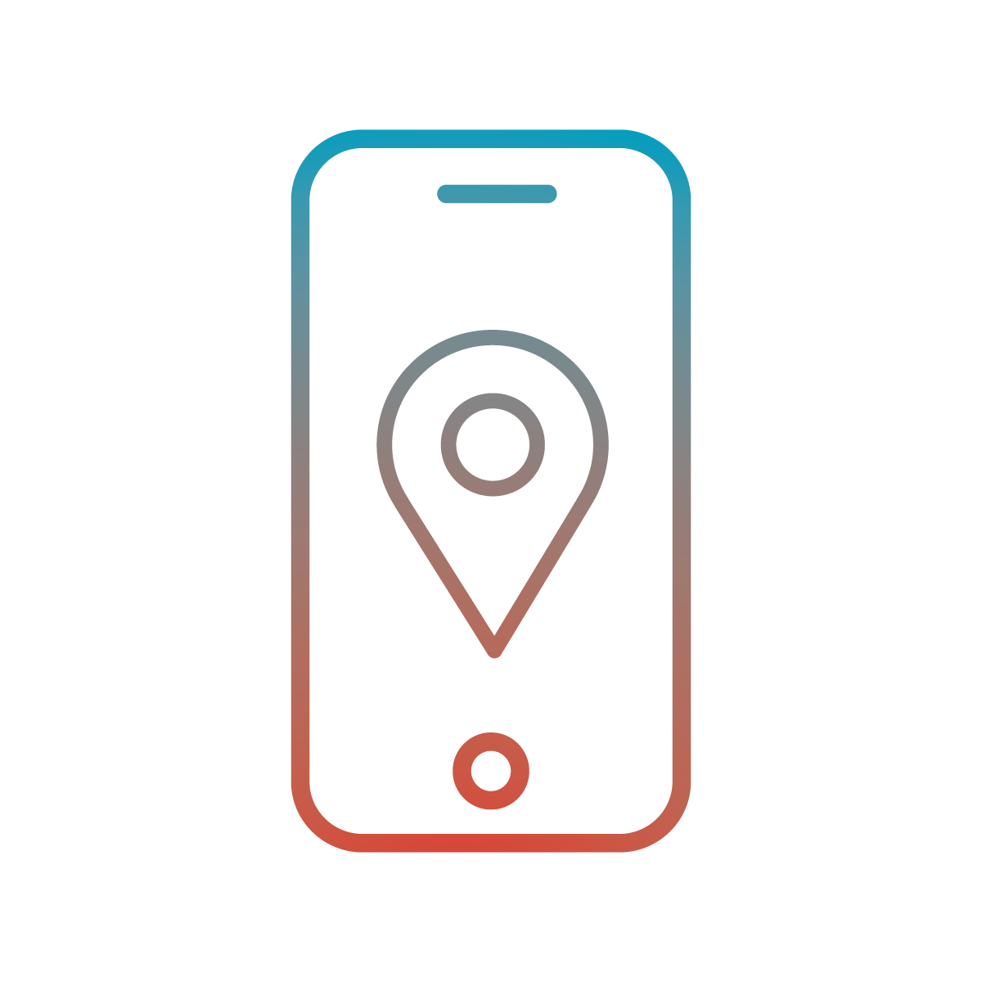
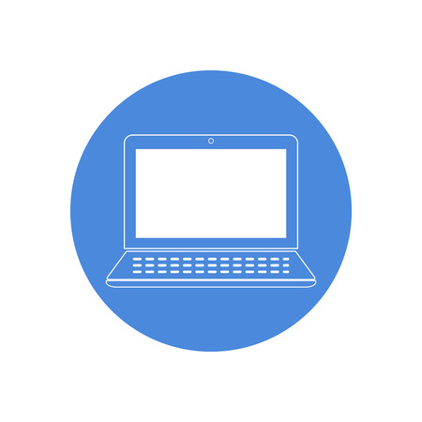
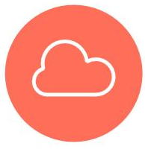
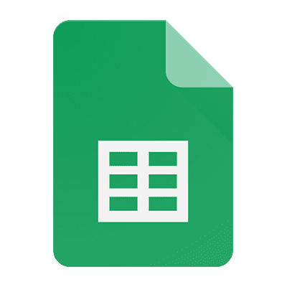
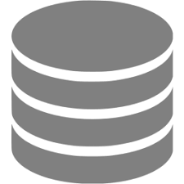
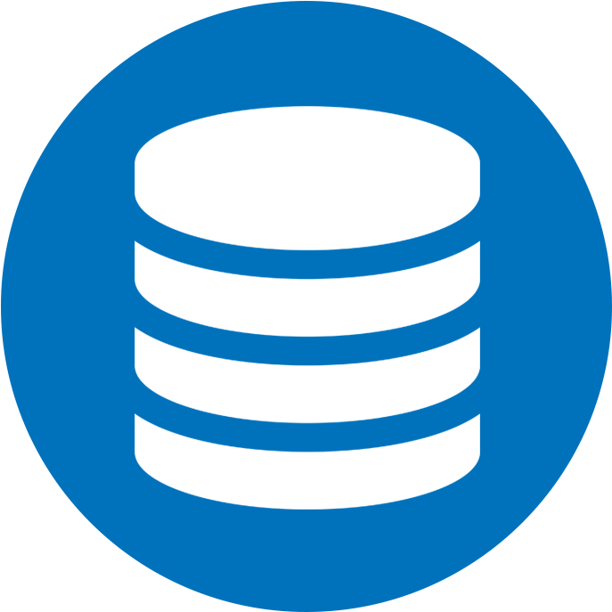
2 Cloud and communications
The communication between the devices occurs via MQTT and the use of a Database.
In particular, the implementation of a cloud solution and the mobile application aim to improve the safety and the accessibility of deaf people.
Mobile App
Web App
CouchDB
MQTT Broker
Mobile App
Google Sheets
Mobile App

Slide 2
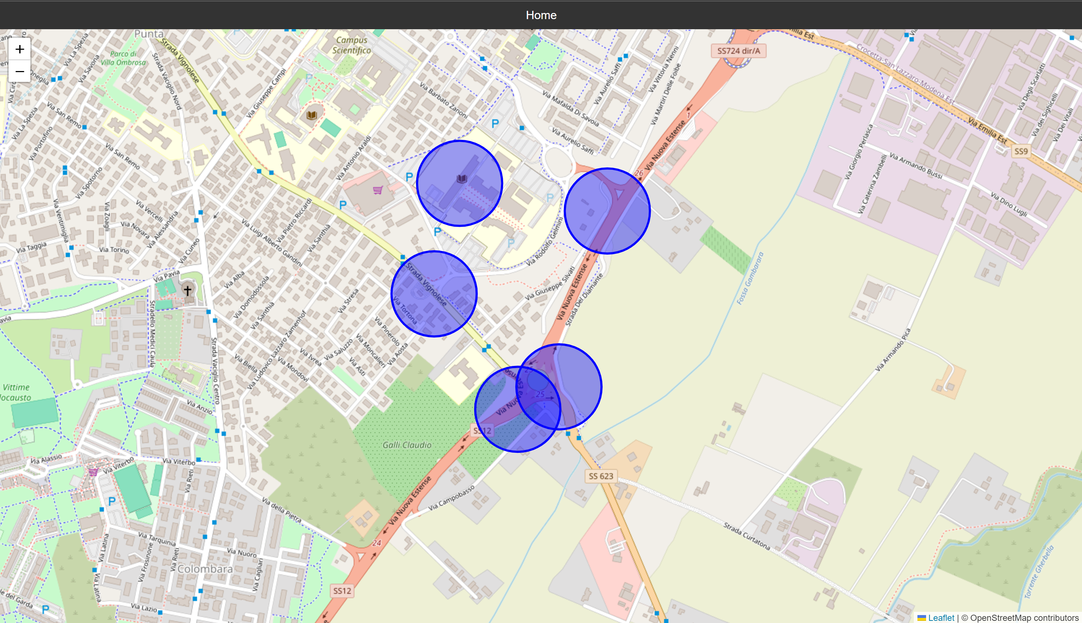
2.1 Web Application
The Web Application provides users with a general view of potentially hazardous areas.
Through the use of coordinates stored in the database, the app visualize dangerous zones on an interactive map.

Slide 3
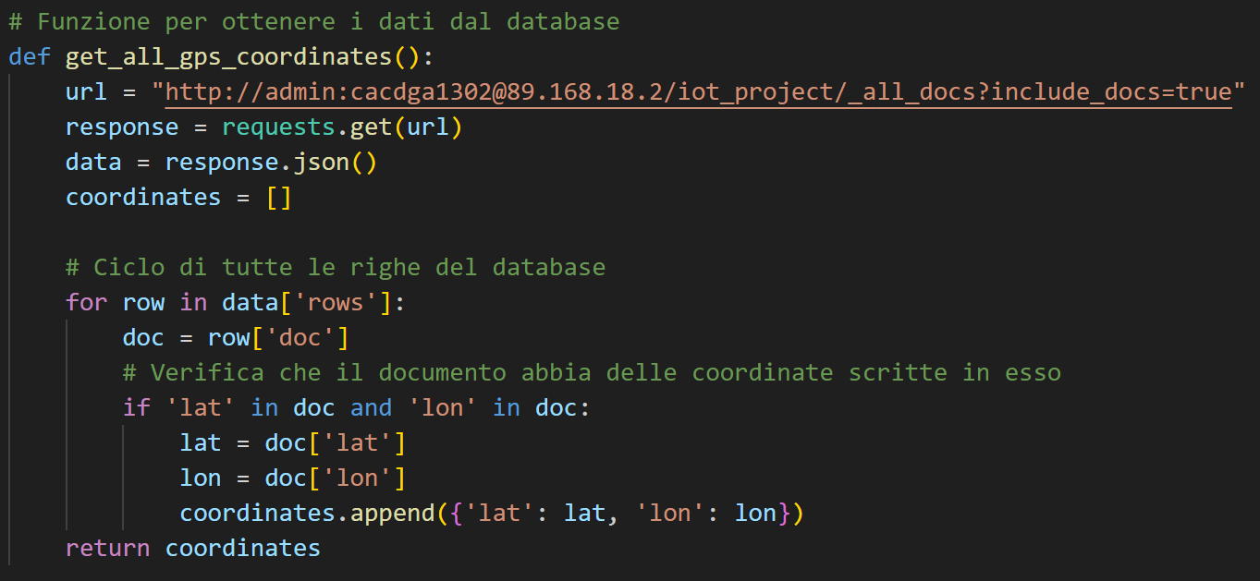
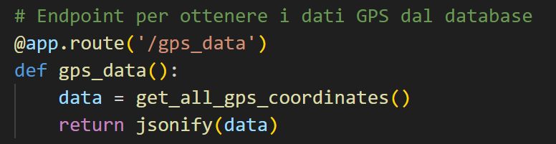
The app takes data from the database periodically, ensuring that the dangerous zones are always kept to date.
app.py

Slide 4
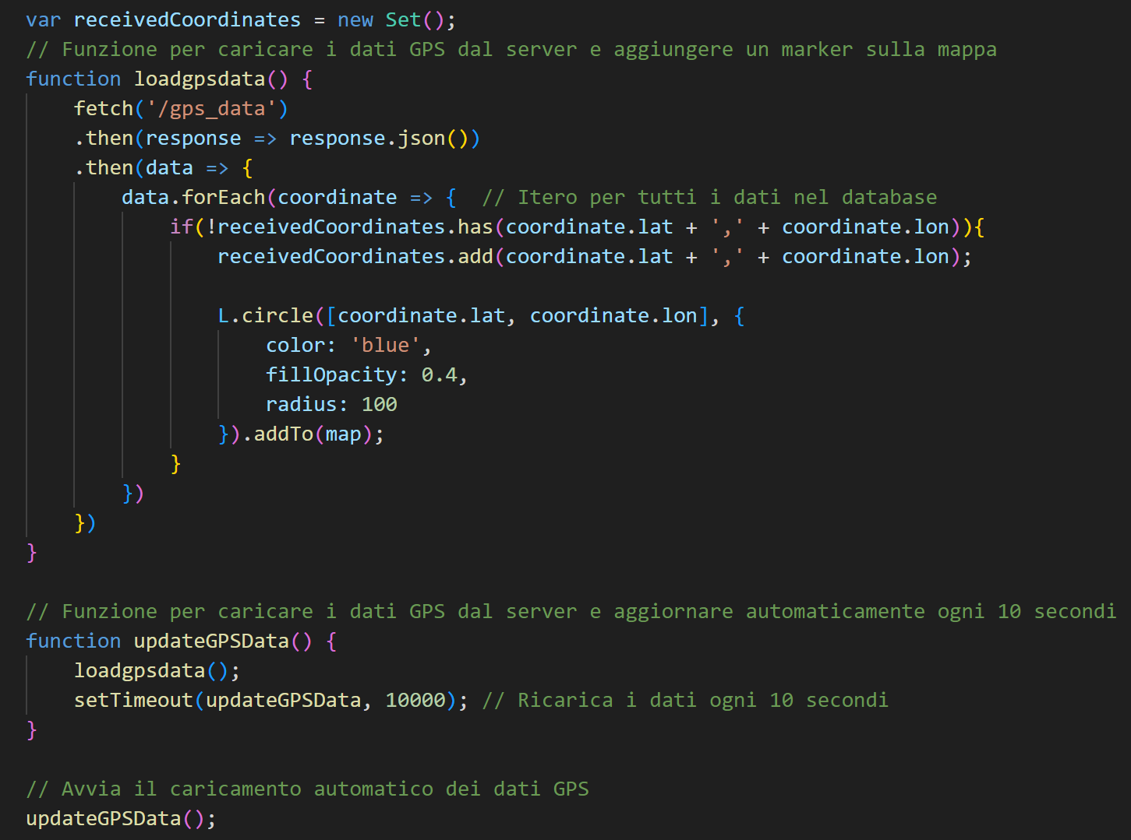
map.html

Slide 5
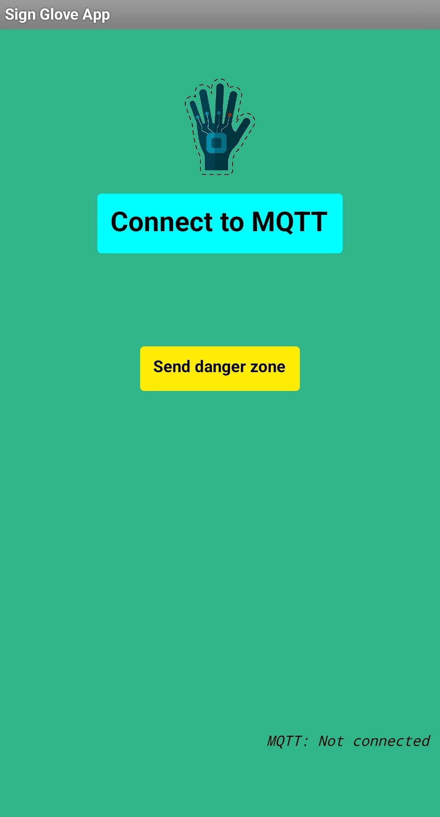
2.2 Mobile Application
Objective: Constantly monitor the user’s location and notify if entering a dangerous zone.
The Communication occurs via MQTT, where both the Broker and the devices work as both publishers and subscribers.
Also, it manages user credentials through the use of Google Sheets.

Slide 6
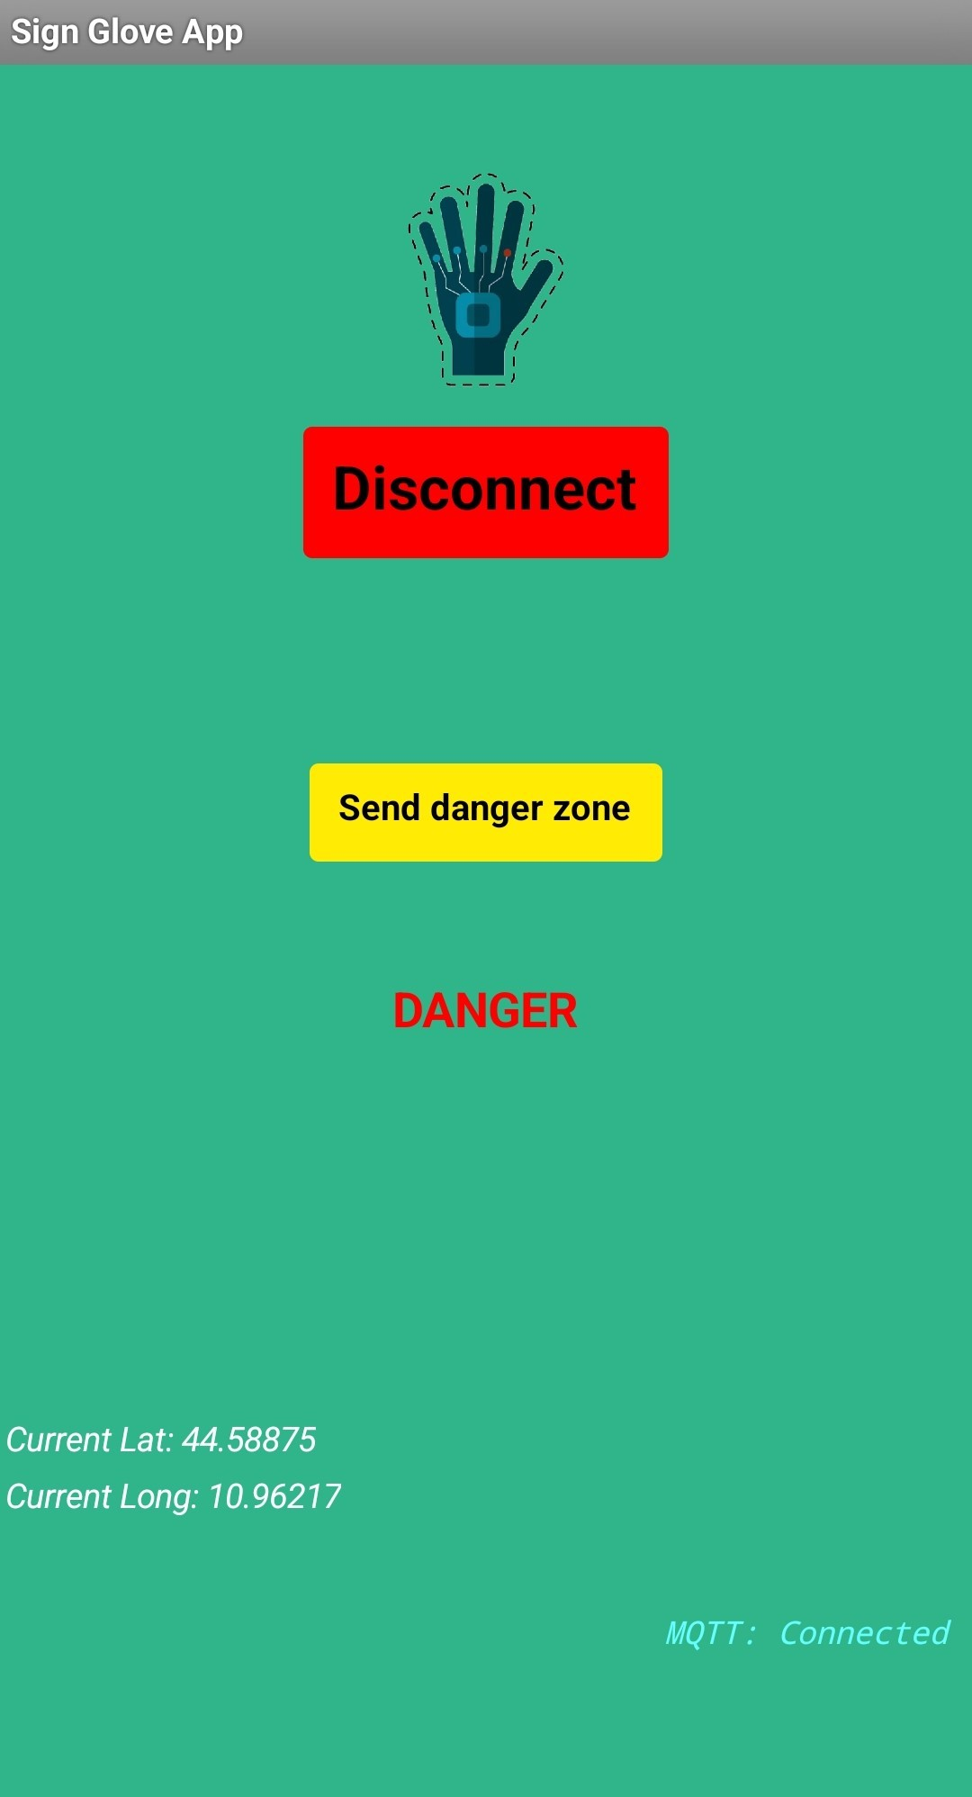
MQTT Communication:
The devices periodically send their current location to the MQTT Broker.
The MQTT Broker checks the received coordinates and sends a danger message if the user is in a hazardous zone.

Slide 7
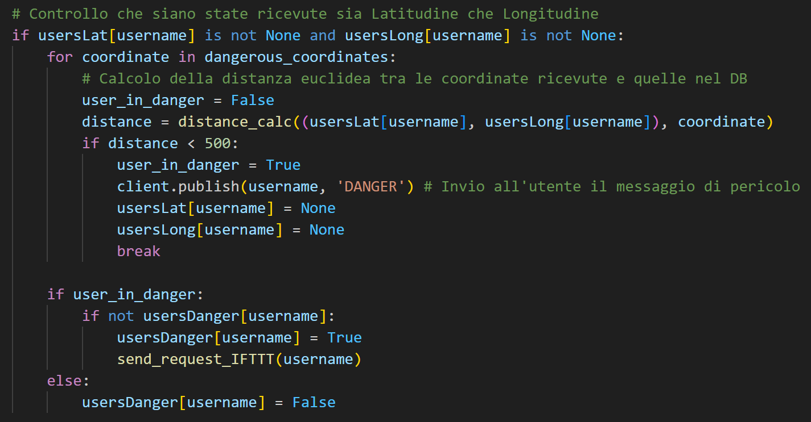
The MQTT Broker also sends a web request to IFTTT, which manages the notification system for the devices.

Slide 8
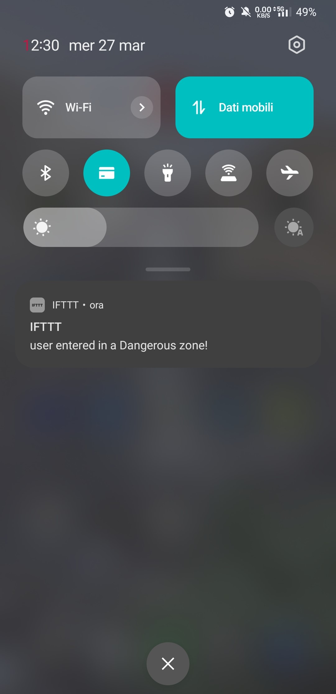
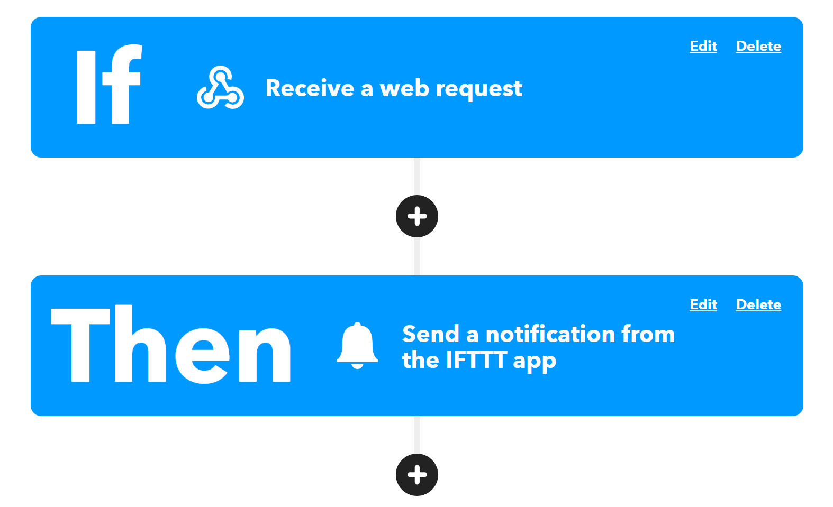
The MQTT Broker also sends a web request to IFTTT, which manages the notification system for the devices.

Slide 9
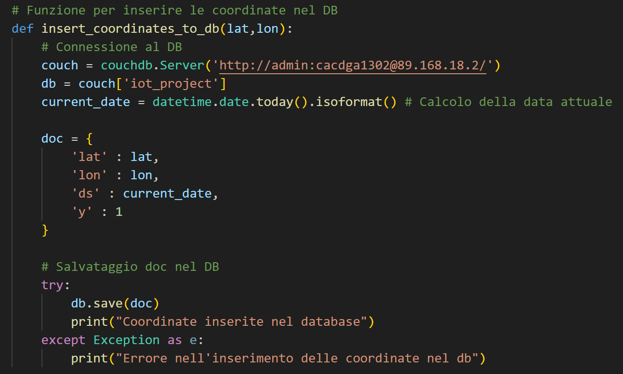
Another feature is the possibility to send a new dangerous location to the MQTT Broker, to be added to the CouchDB database.

Slide 10
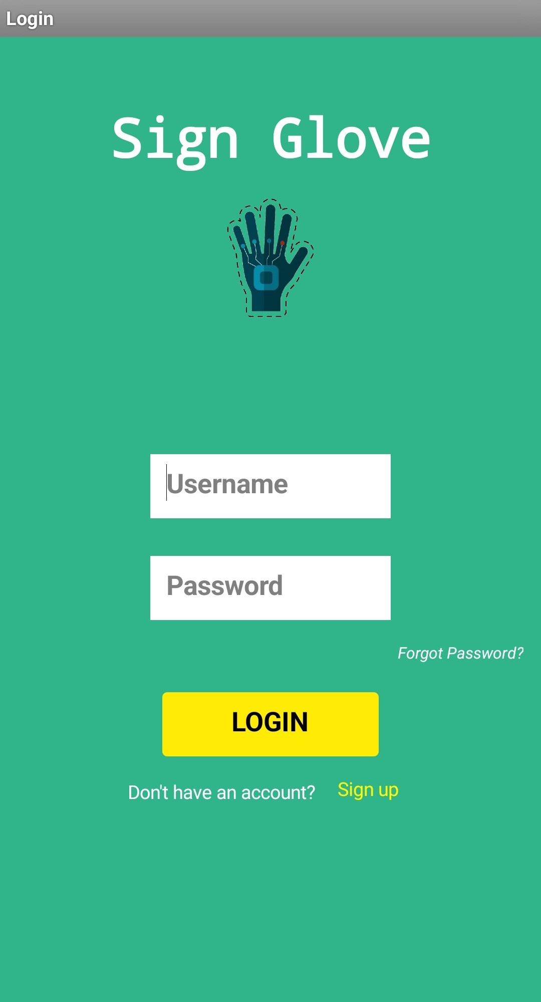
Credential management:
The App enables security and a controlled access, ensured by credential management, through the use of Google Sheets.

Slide 11
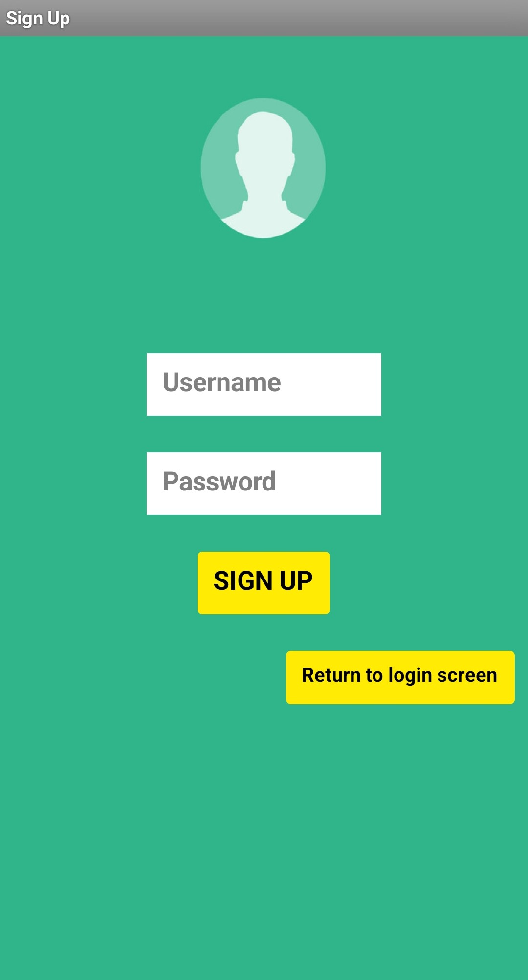
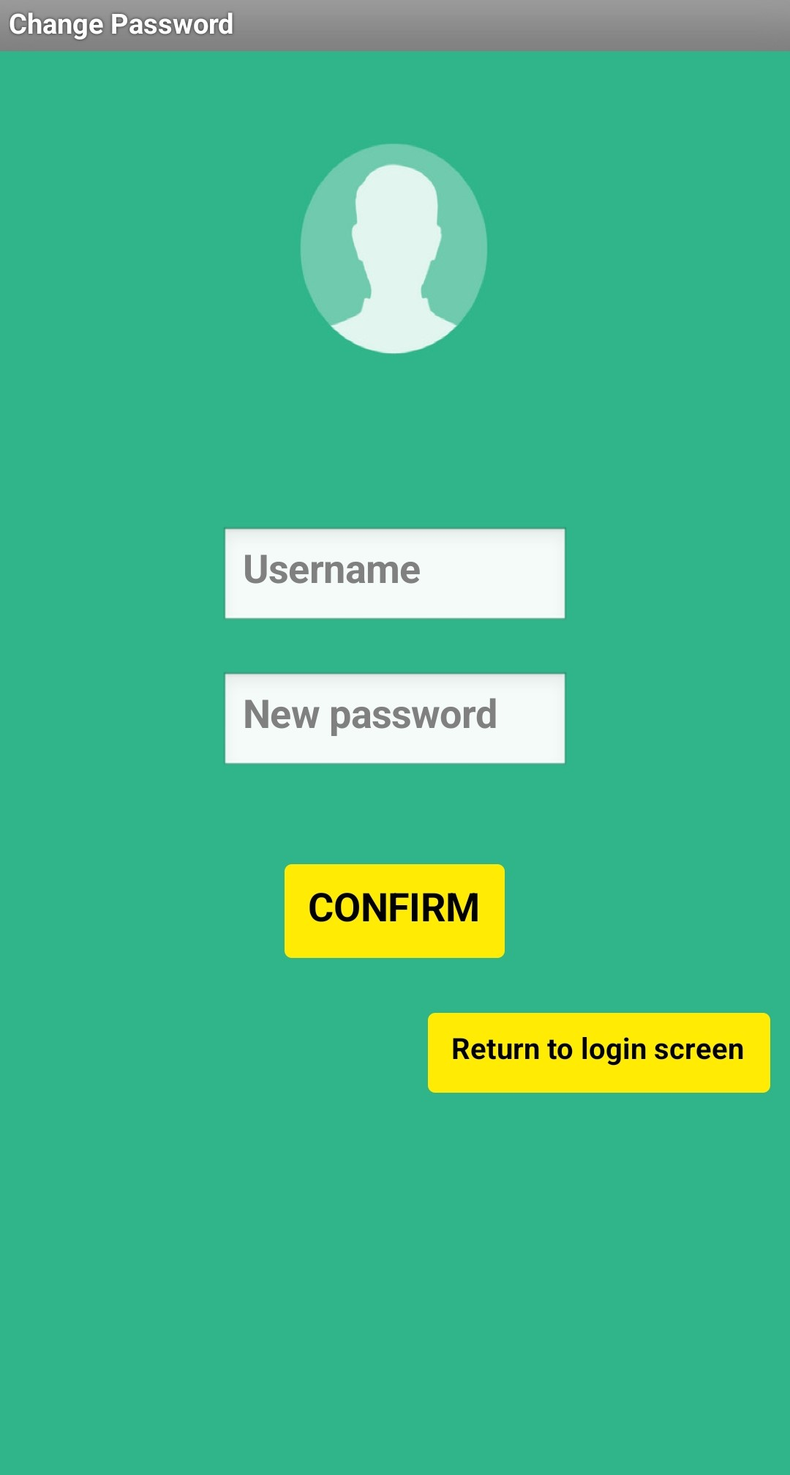

Slide 12
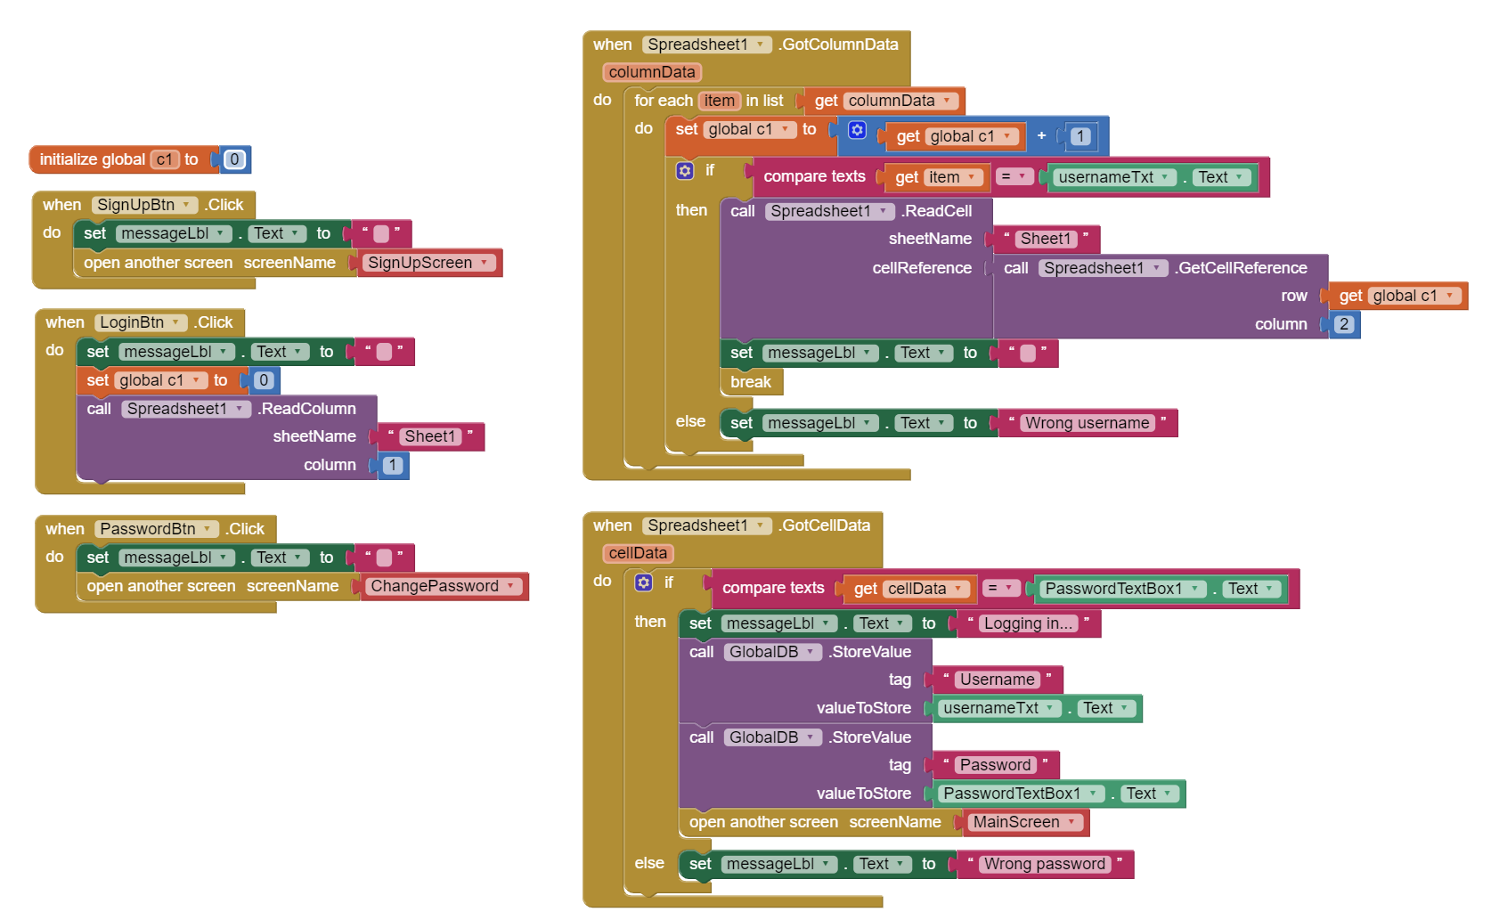
The entire Mobile Application was developed using MIT App Inventor:
Login Screen:

Slide 13
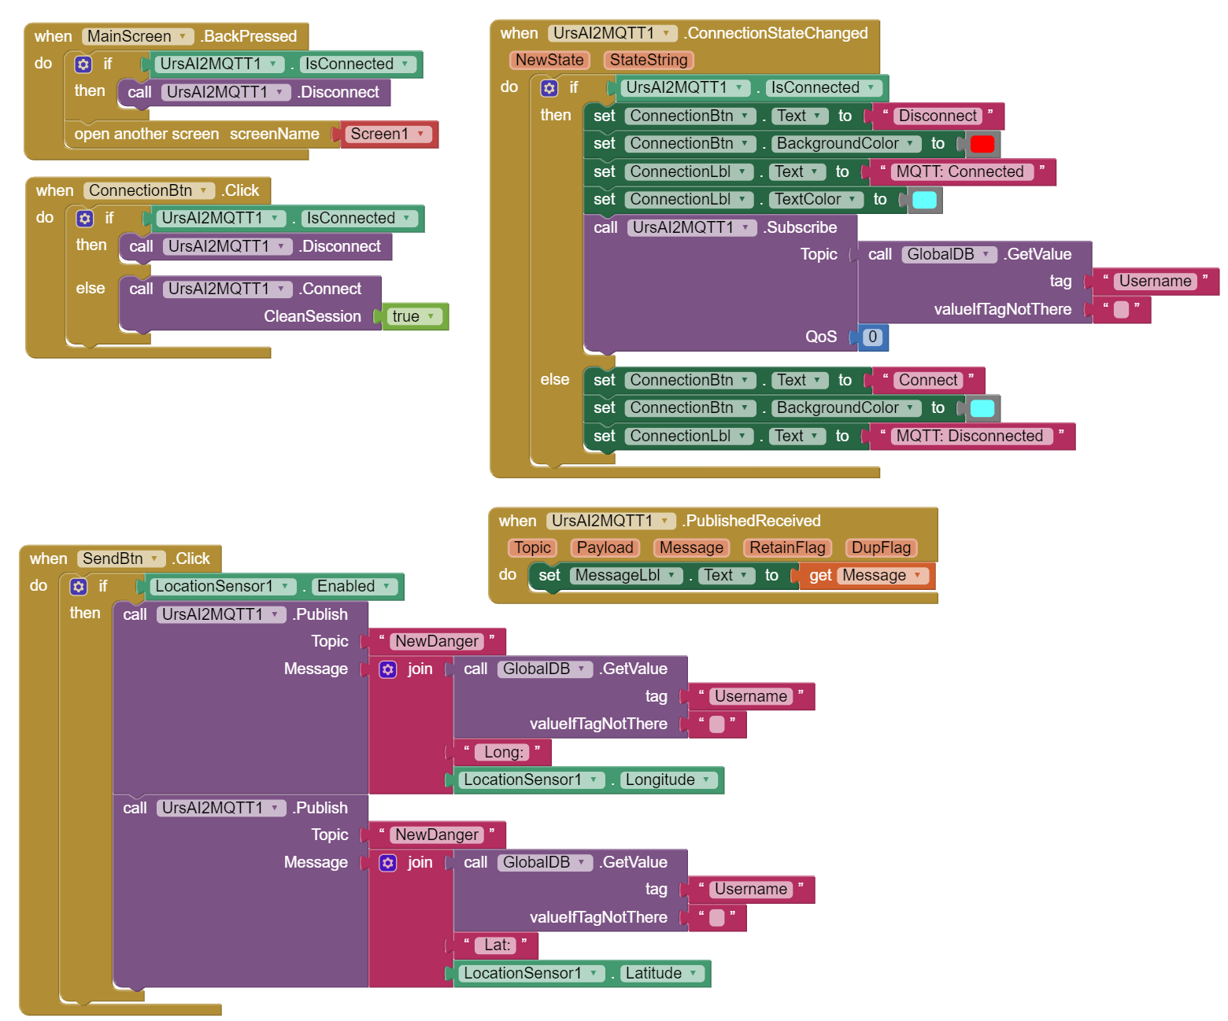
Main Screen (1):

Slide 14
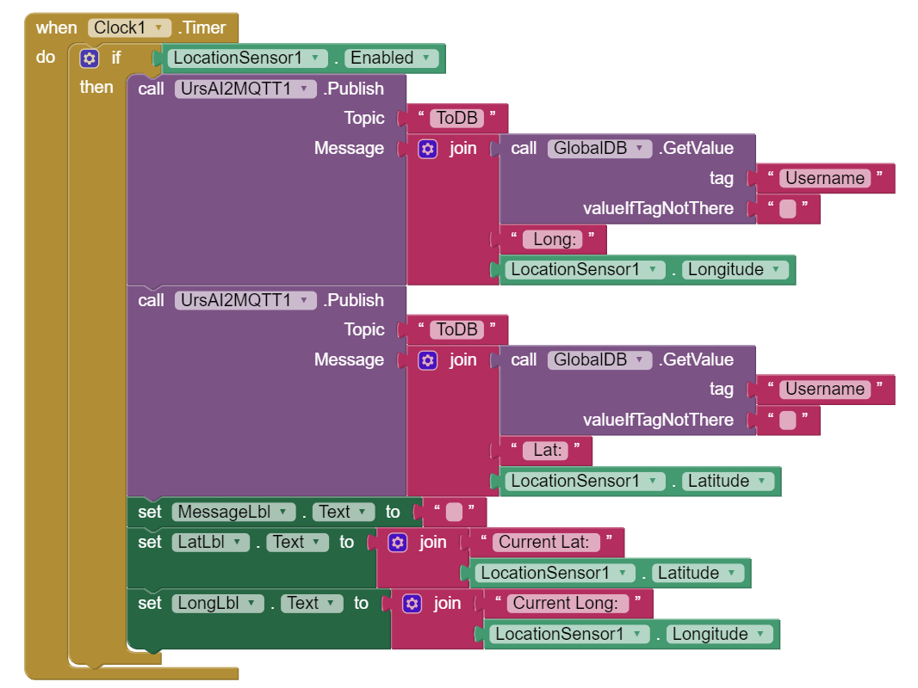
Main Screen (2):

